Slide 1
TRAINING SYSTEM
OPERATING LEASE SUPPORT SYSTEM – PHASE 1
DSF Conference Room, 7 Aug 2015
Participant :
PT. DIPO STAR FINANCE – NBD Dept.
Trainer:
BSI Team
Supported by Mr. Abdul Somad (DSF – NBD Dept.)

Slide 2
Jadwal Training
Jam 08.00 – 10.00 WIB : Pengenalan Aplisasi Operating Lease (OLSS)
Pengenalan Umum Aplikasi OLSS
Modul Yang Tersedia di Aplikasi OLSS
Alur Proses Penggunaan Aplikasi OLSS
Jam 10.00 – 12.00 WIB : Simulasi Penggunaan Aplikasi Operating Lease (OLSS)
Jam 13.00 – 17.00 WIB : Praktek Penggunaan Aplikasi Operating Lease (OLSS)

Slide 3
1. Pengenalan Umum Aplikasi Operating Lease (OLSS)
Maksud dan Tujuan Pembuatan Aplikasi Operating Lease (OLSS):
...........
Gambaran Pengembangan Aplikasi Operating Lease (OLSS):
...........

Slide 4
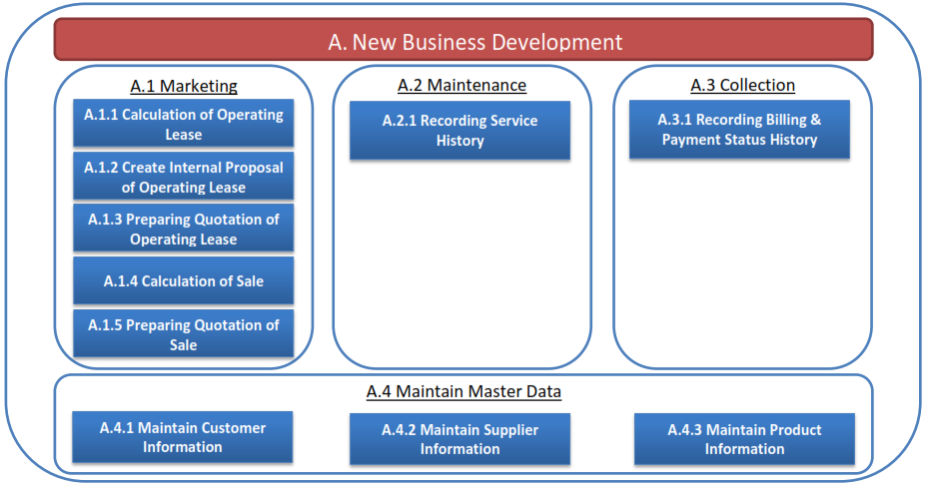
2. Modul Yang Tersedia di Aplikasi Operating Lease (OLSS)
Modul Pada Aplikasi Operating Lease Phase 1

Slide 5
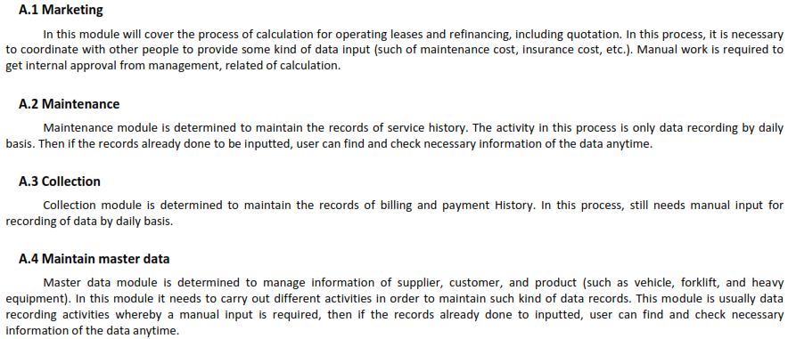
2. Modul Yang Tersedia di Aplikasi Operating Lease (OLSS)
Deskripsi Modul

Slide 6
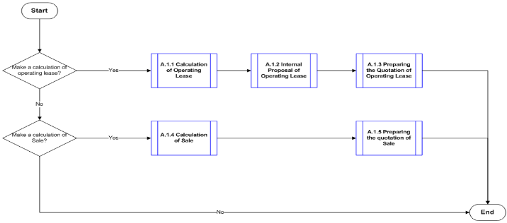
3. Alur Proses Pada Aplikasi Operating Lease (OLSS)
3.1 Modul Marketing

Slide 7
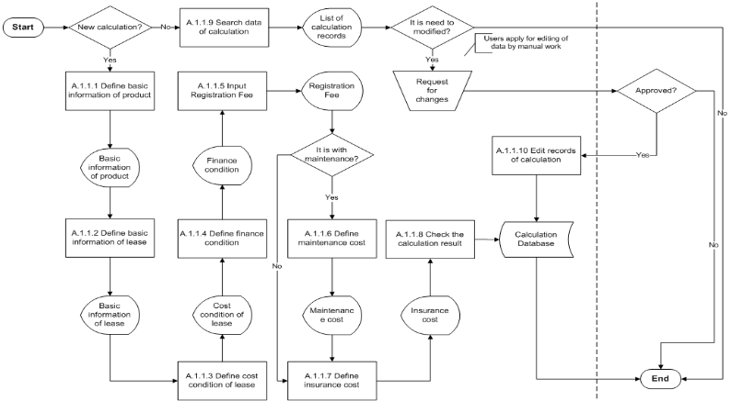
3. Process Flow
3.1.1 Modul Marketing: Menu Calculation of Operating Lease

Slide 8
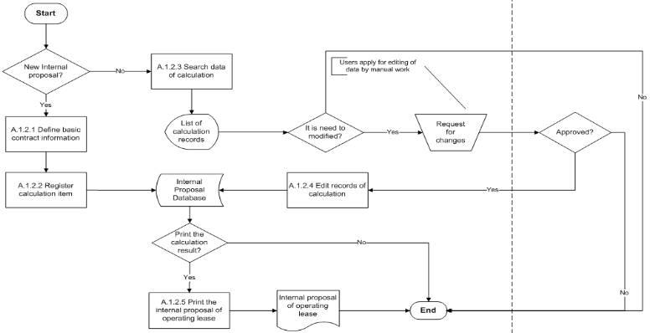
3. Process Flow
3.1.2 Create Internal Proposal of Operating Lease

Slide 9
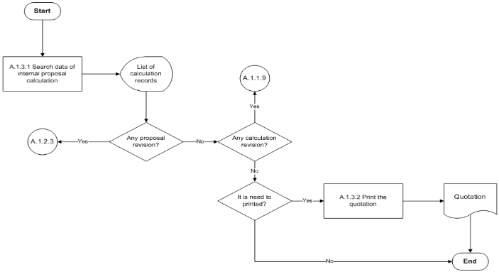
3. Process Flow
3.1.3 Preparing Quotation of Operating Lease

Slide 10
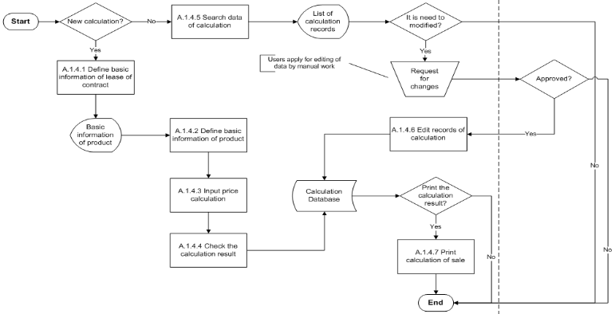
3. Process Flow
3.1.4 Calculation of Sale

Slide 11
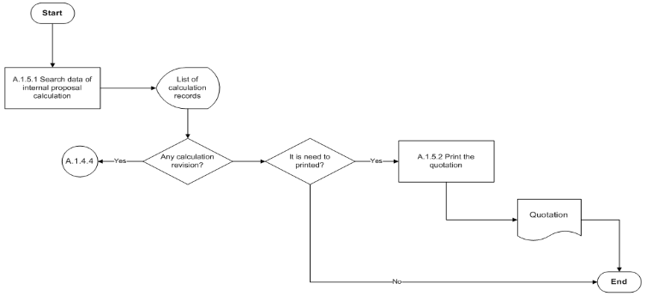
3. Process Flow
3.1.5 Preparing Quotation of Sale

Slide 12
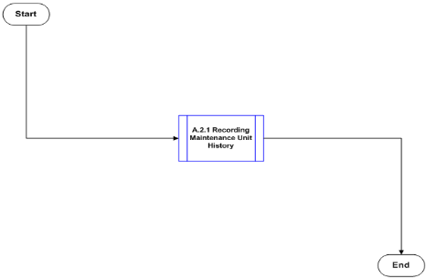
3. Process Flow
3.2 Maintenance

Slide 13
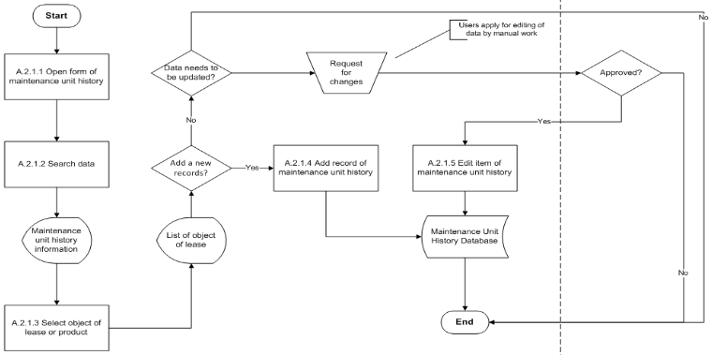
3. Process Flow
3.2.1 Recording Maintenance Unit History

Slide 14
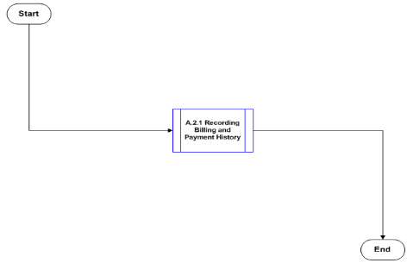
3. Process Flow
3.3 Collection

Slide 15
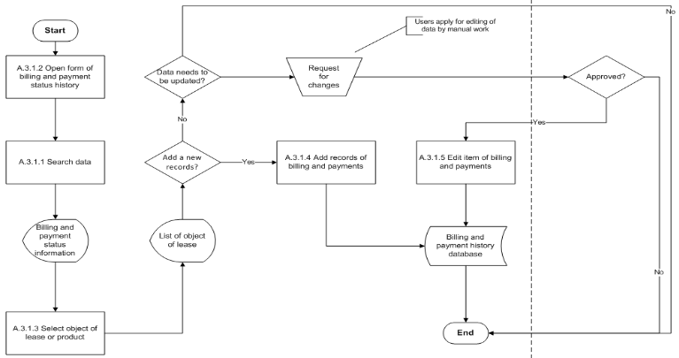
3. Process Flow
3.3.1 Recording Billing and Payment History

Slide 16
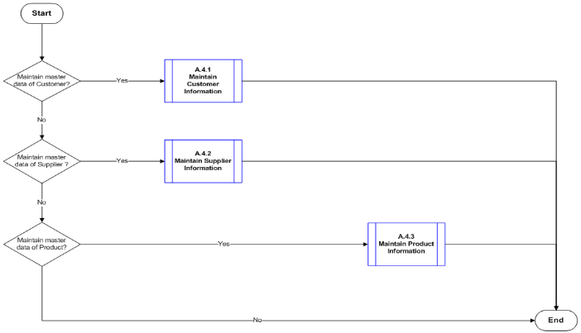
3. Process Flow
3.4 Maintenance Master Data

Slide 17
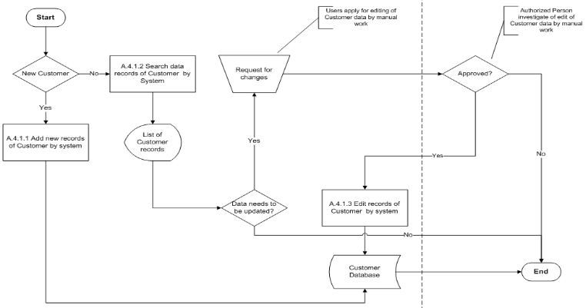
3. Process Flow
3.4.1 Maintenance Customer Information

Slide 18
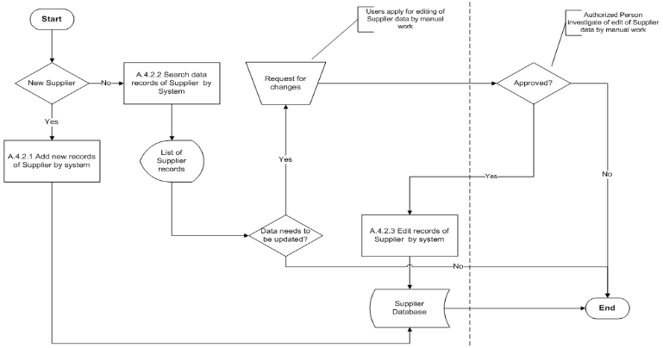
3. Process Flow
3.4.2 Maintenance Supplier Information

Slide 19
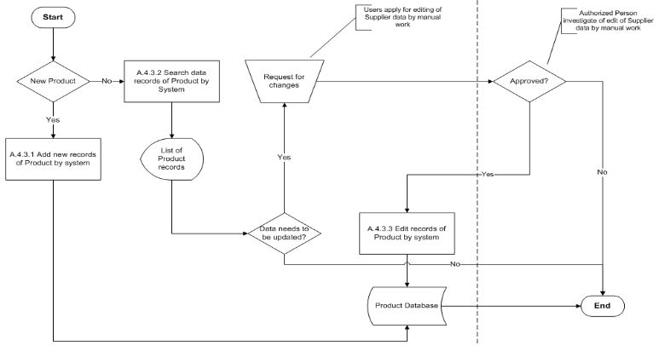
3. Process Flow
3.4.3 Maintenance Product Information

